Slide 1



SPECS Space A COMPETITIVE CHALLENGE PLATFORM WITH GAME ELEMENTS USING PROGRESSIVE WEB APPLICATION FRAMEWORK.

Slide 2
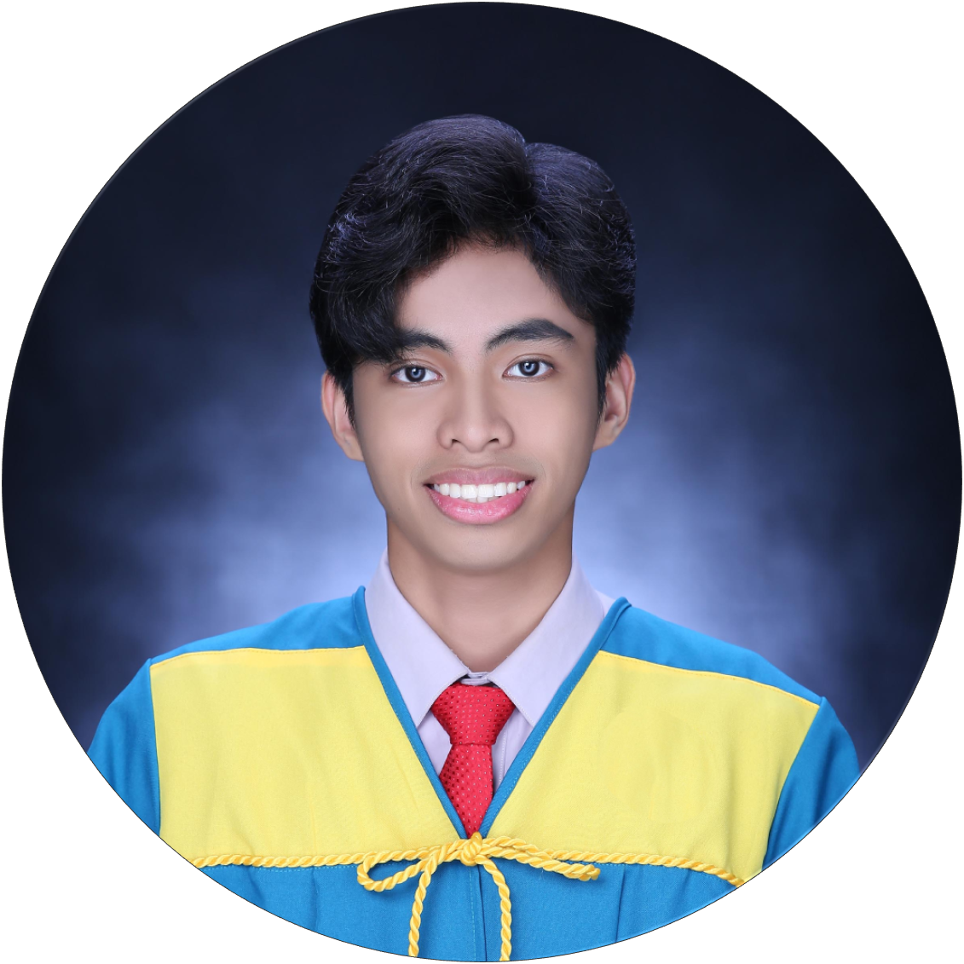
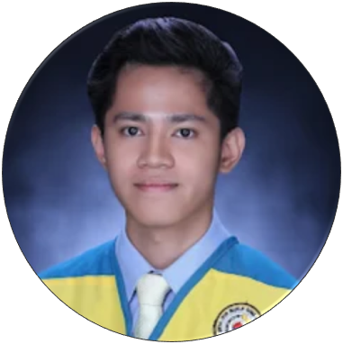
Project Proponents
SPECS Space
Ayran, Joshua
BSCS-3A
Student of College of Computer Studies
In Gordon College
Ferdes, Justin Louise
BSCS-3A
Student of College of Computer Studies
In Gordon College

Slide 3
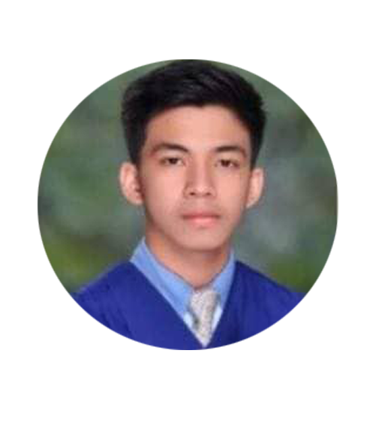
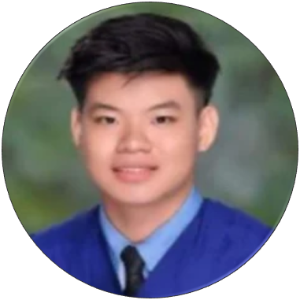
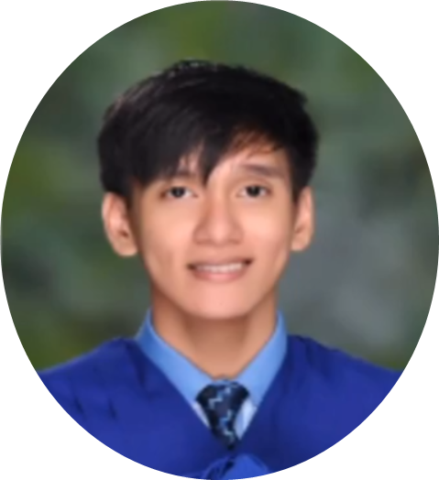
Project Proponents
SPECS Space
Lumbang, Enrique Raymond
Student of College of Computer Studies
In Gordon College
Paruginog, John Ulysses
Student of College of Computer Studies
In Gordon College
Takahashi, Kanji
Student of College of Computer Studies
In Gordon College

Slide 4
Purpose of the Study
SPECS Space
Promotes students engagement with SPECS organization
Implementation of game elements in school activities
To identify individuals who demonstrate active engagement and proficiency in the domain of computer science.

Slide 5



Problem Statement:
Engagement of students on SPECS organization
Achievements
Lack of competition
Observing if gamification affects students engagement
SPECS Space

Slide 6
Conceptual Framework
SPECS Space
Input
Designing and Development of a Progressive Web Application for the SPECS organization.
Beneficiary Verification and Participation
Process
Deployment of the system
SPECS user and Admin
experience survey gathering
Output
Assessment of system quality and consistency through analyzing gathered results
Feedback Evaluation And Implementation

Slide 7
Research Method
SPECS Space
Adaptive Software Development
Speculate
Collaborate
Learn

Slide 8
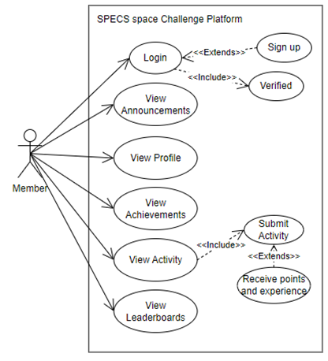
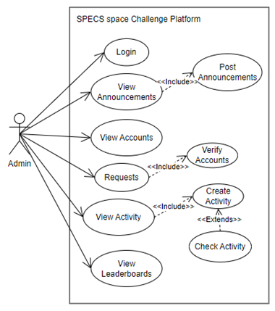
SPECS Space
Requirements Analysis (Use Case)
Member
Admin

Slide 9
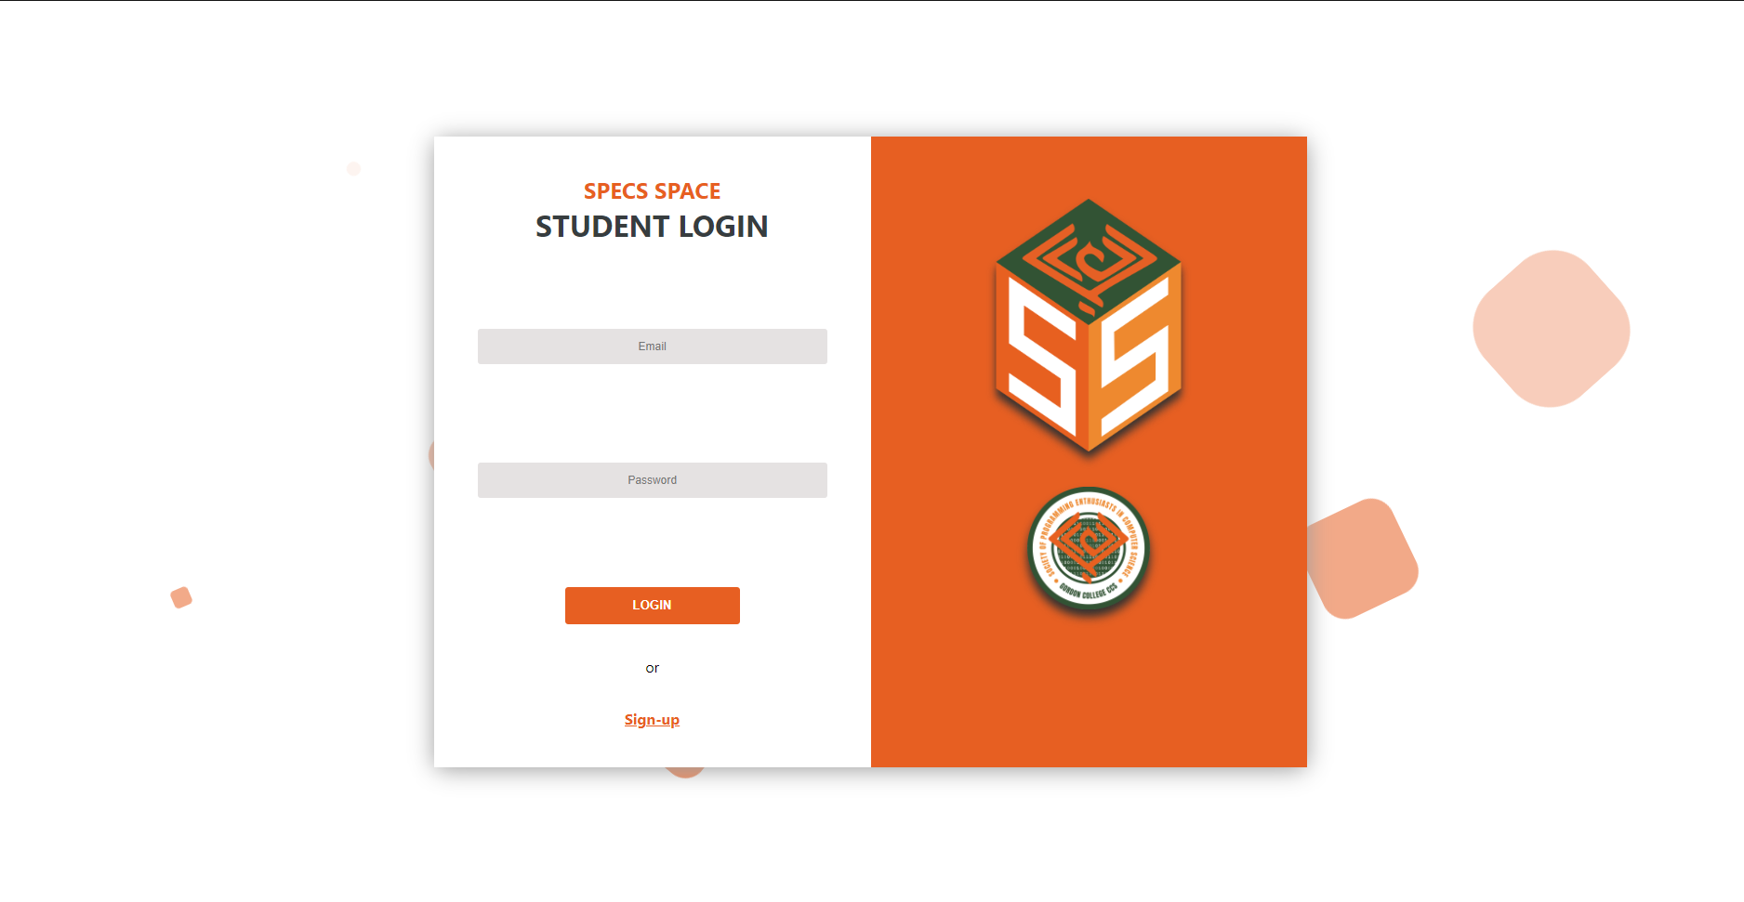
System User Interface (Web)

Slide 10

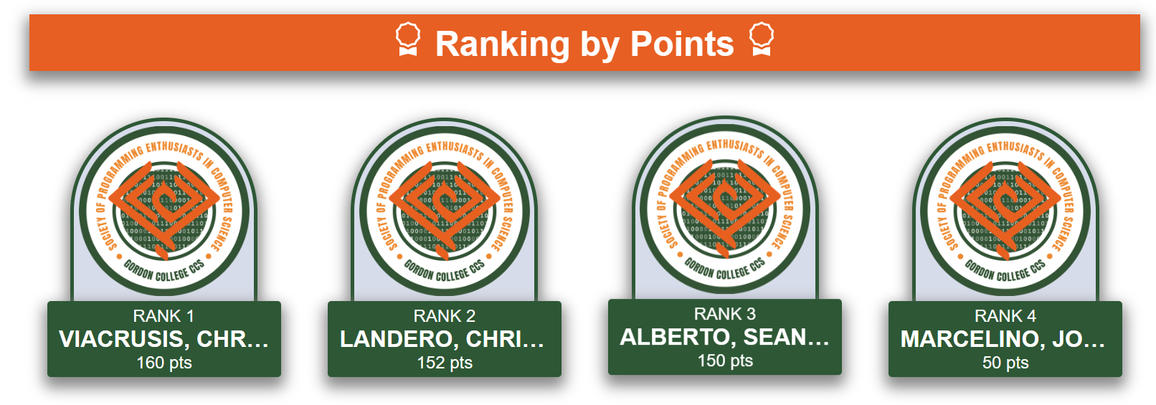
Leaderboards

Slide 11
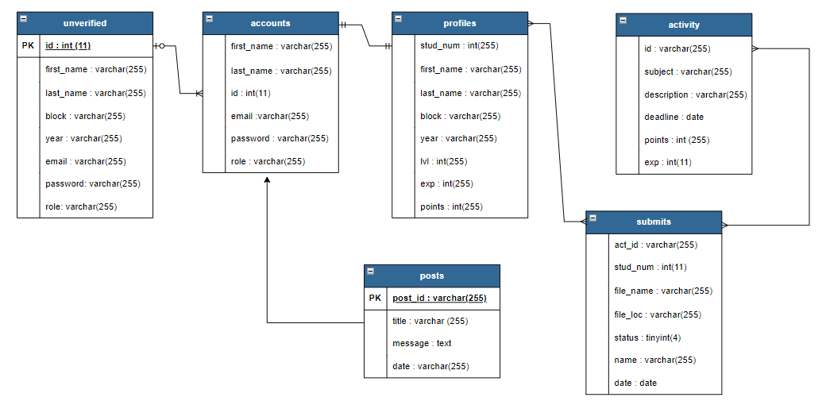
Entity Relationship Diagram:

Slide 12
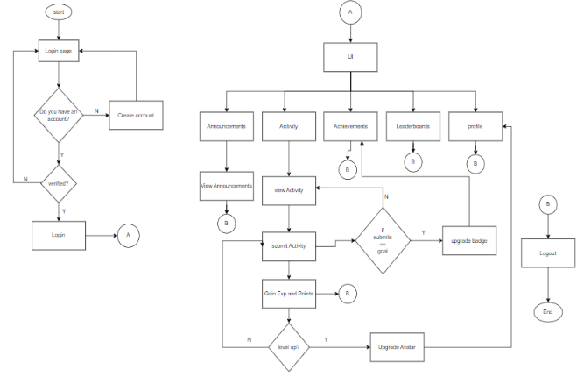
Flowchart of the System:
Member’s Flowchart

Slide 13
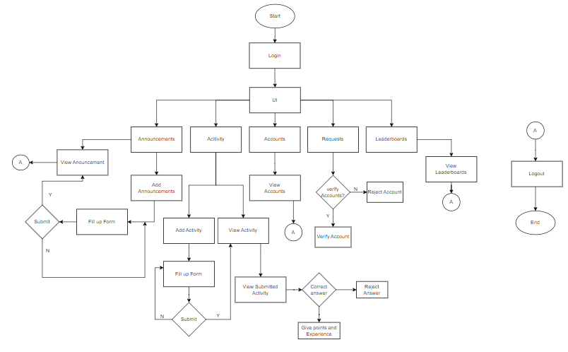
Flowchart of the System:
Admin’s Flowchart

Slide 14
Hardware Requirements:
Personal Computer (Desktop, Laptop)
RAM (recommends about 30 MB per concurrent user session.)
Software Requirements:
Operating System (Windows, Linux, macOS)
Web browser (Minimum Internet Explorer, Versions 7 to 10)

Slide 15
Specifications:
HTML/CSS/React.js
PHP
MySQL
Front-end
Back-end
Database

Slide 16
Conflicts Encountered:
CORS Policy Error
Low Lighthouse Performance Score

Slide 17
Division of Labor
Joshua Ayran
Enrique Lumbang
Kanji Takahashi
Justin Louise Ferdes
John Ulysses Paruginog
Front-end
Front-end
Front-end
Back-end
Back-end

Slide 18
Thank you for listening!

